Slide 1

Simulation of Solar Photolysis of Organic Hydroperoxides ROOH (tert-butyl hydroperoxide)
Helen Clifford
CyberTraining Workshop 2026

Slide 2
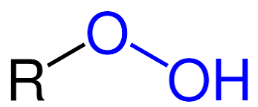
Background and Motivation
Organic hydroperoxides serve as an important intermediate in the formation of secondary organic aerosols
From UV radiation, the O-O bond can dissociate on a repulsive excited state leading to RO+OH radical products
Experimental evidence shows two possible mechanistic pathways and electronic states for RO-OH dissociation*:
Direct dissociation on S₁ suggested to be the dominant pathway but also evidence of internal conversion through S₁/S₀ degeneracy followed by ground-state dissociation*
*Zou, M. et al., J. Phys. Chem. A 2025, 129 (13), 3052−3062
Notes:
Organic hydroperoxides serve as an important intermediate in the formation of secondary organic aerosols

Slide 3
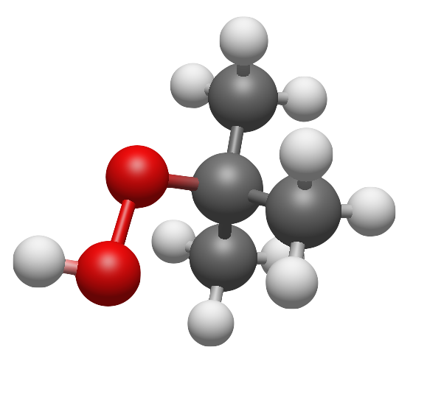
Outline and Research Objective
System of Interest:
Performing NAMD simulations with PySPAWN on tert-butyl hydroperoxide
Objective: After excitation, which electronic surface and through which pathway does tert-butyl hydroperoxide undergo RO–OH bond homolysis?
O–O homolysis occurs on S₁ or after transition through S₁/S₀ internal conversion
tert-butyl hydroperoxide (TBHP)

Slide 4



Electronic Structure Methods
Single Reference:
HF, KS-DFT
Multi-Reference:
FCI, MCSCF, MRCI
$$+$$
$$+$$
$$+$$
…

Slide 5


Complete Active Space Self Consistent Field (CASSCF)
Complete Active Space Wave Function
CASSCF:
Recovers correlation internal but misses correlation external to active space
Nontrivial choice of active space
Post CASSCF:
Aim to recover remaining external correlation
Virtual
Active
$$+$$
$$+$$
…
Inactive

Slide 6
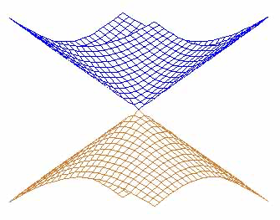
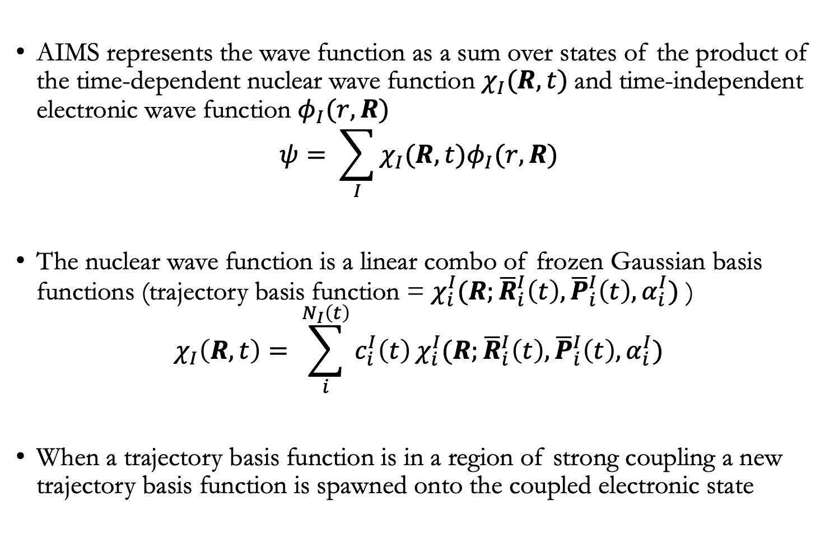
Ab Initio Multiple Spawning (AIMS)
AIMS represents the wave function as a sum over states of the product of the time-dependent nuclear wave function $χ_{I}(R,t)$and time-independent electronic wave function $φ_{I}(r,R)$
$$ψ= \sum_{I}{χ_{I}(R,t)φ_{I}(r,R)}$$
The nuclear wave function is a linear combo of frozen Gaussian basis functions (trajectory basis function = $χ_{i}^{I}(R;{\overline{R}}_{i}^{I}\left(t\right),{\overline{P}}_{i}^{I}\left(t\right),α_{i}^{I})$ )
$$χ_{I}\left(R,t\right)= \sum_{i}^{N_{I}\left(t\right)}{c_{i}^{I}\left(t\right)}χ_{i}^{I}(R;{\overline{R}}_{i}^{I}\left(t\right),{\overline{P}}_{i}^{I}\left(t\right),α_{i}^{I})$$
When a trajectory basis function is in a region of strong coupling a new trajectory basis function is spawned onto the coupled electronic state

Slide 7
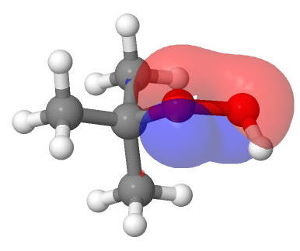
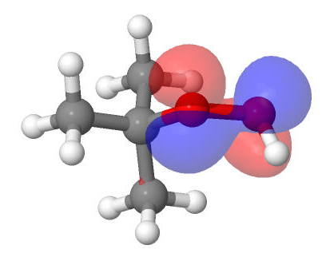
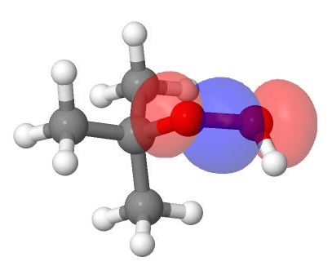
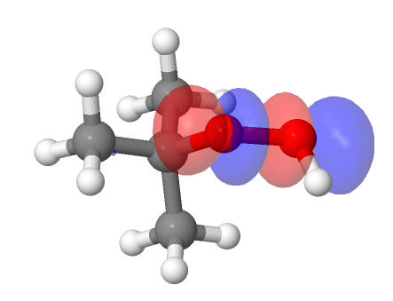
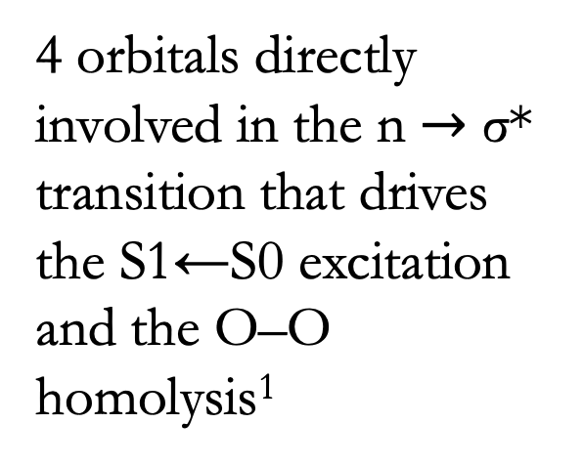

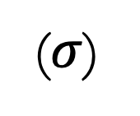
Active Space: SA(4)-CASSCF(6e,4o)
4 orbitals directly involved in the n $→$ σ* transition that drives the S1←S0 excitation and the O–O homolysis¹
(n)
(n)
($σ$)
($σ$*)
¹Zou, M. et al., J. Phys. Chem. A 2025, 129 (13), 3052−3062

Slide 8
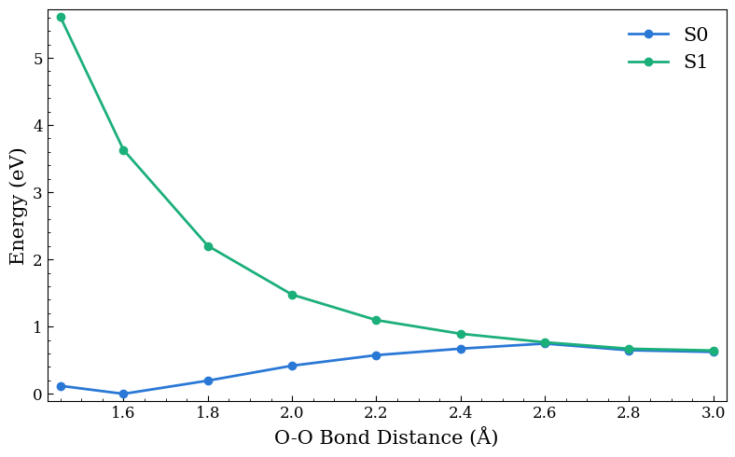
Potential Energy Surface
S₁ is steep and repulsive indicative of rapid dissociation
S₁ becomes degenerate with S₀ at large O-O distances
Relaxed curves(with respect to S₁) were computed at SA(4)-CASSCF(6e,4o) level of theory
SA(4) since S₂ and S₃ lie close in energy to S₀ and S₁
Inclusion of more states helps stabilize and balance along the bond-breaking coordinate
Zero of energy is taken relative to the S₀ minimum
Notes:
Both electronic states lead to the same cyclopentoxy + OH product asymptote
σ*←n transitions

Slide 9
Dynamics Set Up and Details
Hessian/frequency calculation on S₀ equilibrium geometry for preparing initial conditions from Wigner distribution
Generated initial conditions through random seed that sets Wigner-sampled momenta and positions
Propagate SA(4)-CASSCF AIMS dynamics initialized on S₁ (ts = 0.5 fs, timescale = 750 fs)
Analysis for trajectories
Defined a RO-OH bond cleavage threshold of 2.6 Å: operational choice of ~1 Å above equilibrium geometry RO-OH bond length (1.4-1.6 Å)
2.6 Å is beyond the steep portion of repulsive S₁ curve and beginning of state degeneracy of S₁/S₀
Notes:
elocity-Verlet classical propagator (clas_prop = "vv"), full diagonalization for the quantum amplitude equations (qm_prop = "fulldiag"), adiabatic representation (qm_ham = "adiabatic")

Slide 10
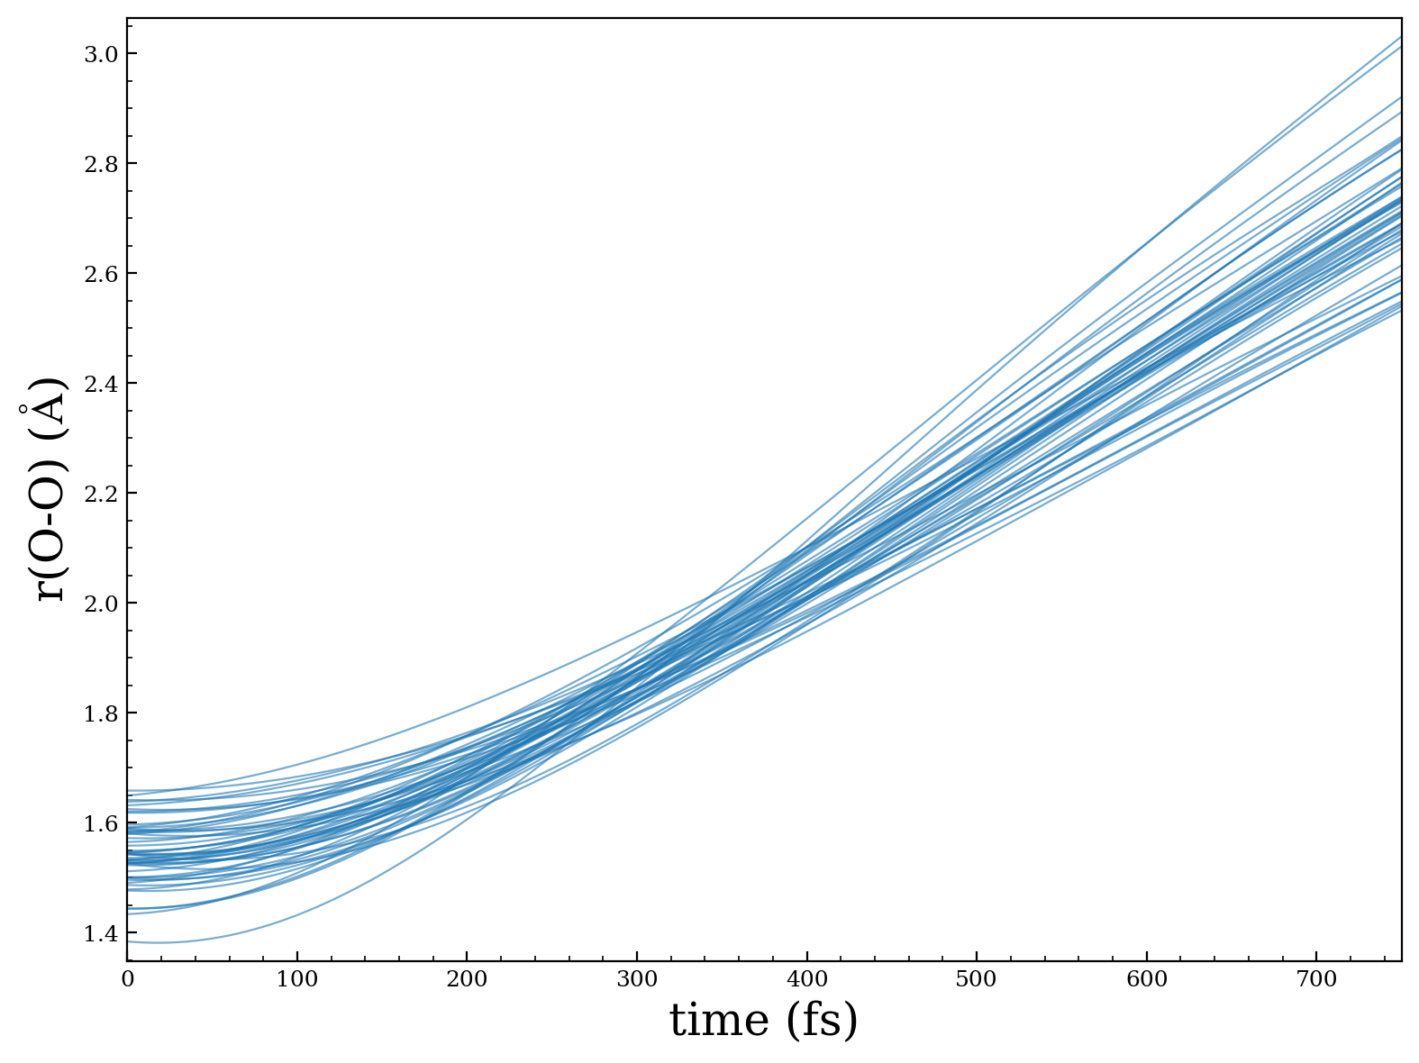
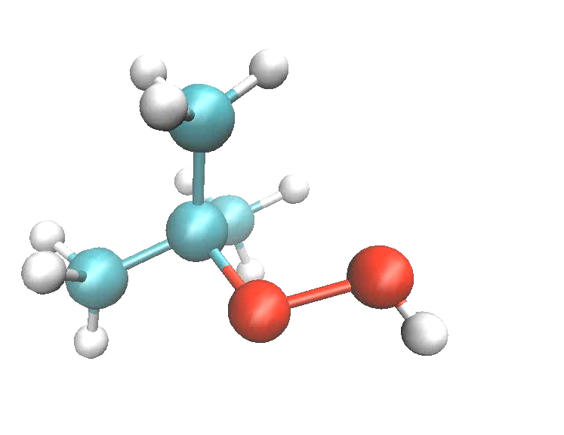
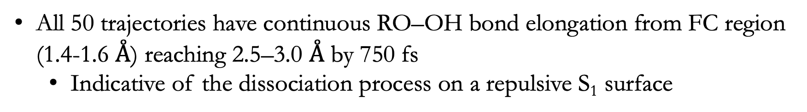
Time evolution of RO-OH bond distance
All 50 trajectories have continuous RO–OH bond elongation from FC region (1.4-1.6 $Å$) reaching 2.5–3.0 $Å$ by 750 fs
Indicative of the dissociation process on a repulsive S₁ surface

Slide 11
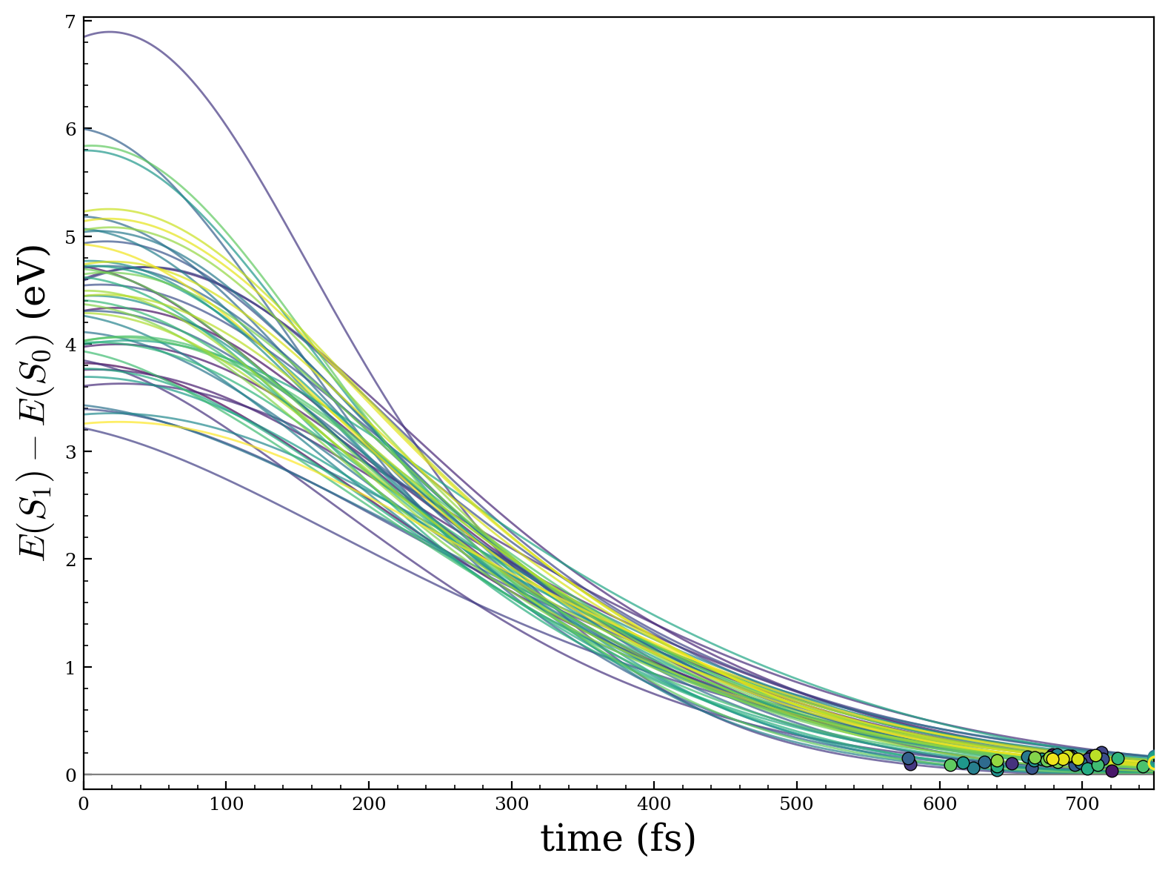
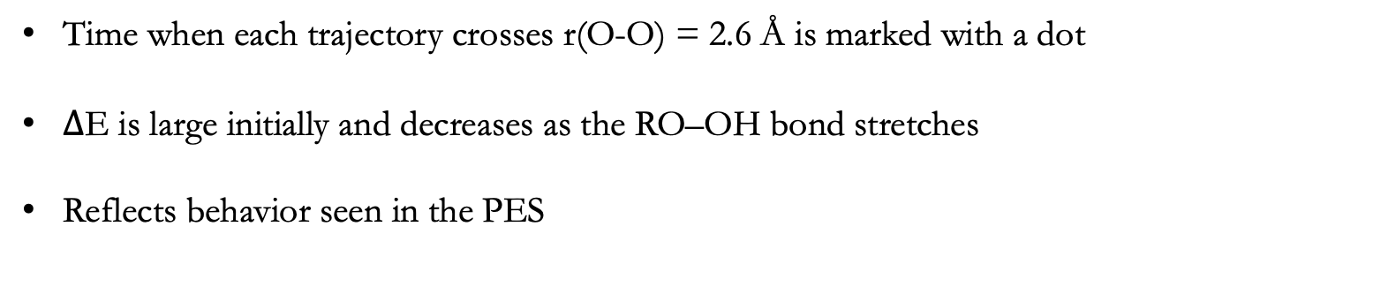
Dynamics Results
Time when each trajectory crosses r(O-O) = 2.6 Å is marked with a dot
$∆$E is large initially and decreases as the RO–OH bond stretches
Reflects behavior seen in the PES

Slide 12
Interpretation and Results
All 50 trajectories initiated on S₁ remained on S₁ during the 750 fs simulation, no observed spawns to S₀
Could indicate that RO-OH bond dissociation occurs on S₁ curve rather than through internal conversion and strong coupling to the S₀ along O-O stretching coordinate
For AIMS, spawning is dependent on the nonadiabatic coupling vector rather than just the electronic state energy gap
Near degeneracy shown in the PES may not guarantee spawning onto different electronic states.

Slide 13
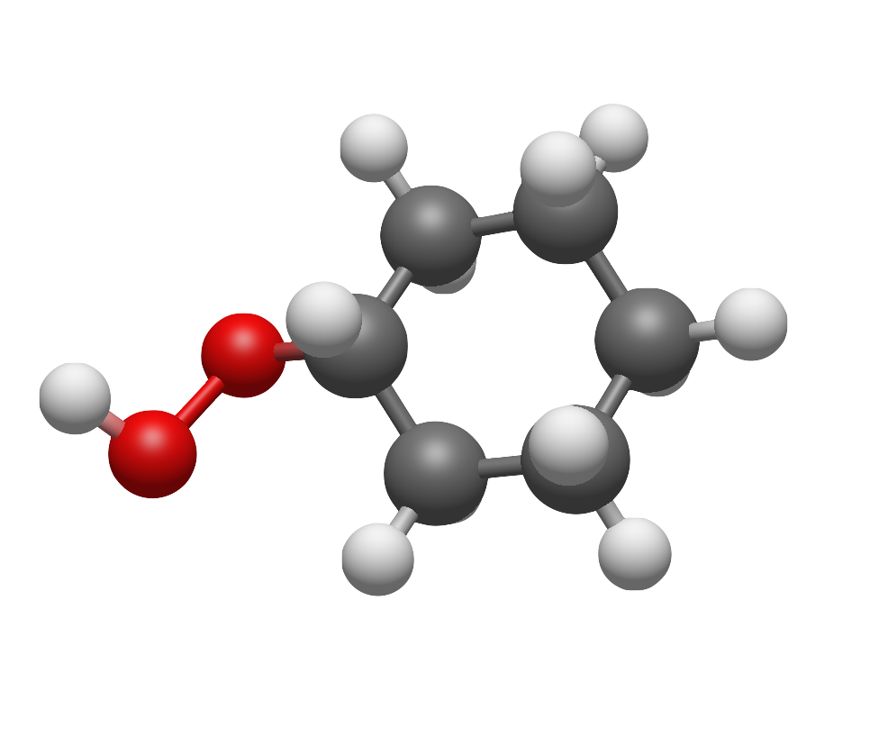
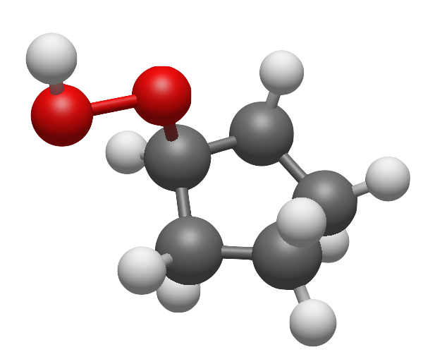
Conclusions and Future Work
AIMS dynamics with SA-CASSCF with 50 trajectories show direct dissociation on S1 surface as the dominant mechanistic pathway along O-O stretching coordinate.
Current work could indicate predominant sampling from O-O stretching coordinates.
Extended sampling from torsional or O-O-H bending coordinates could provide different results
Additional organic hydroperoxides: cyclohexyl and cyclopentyl
Running dynamics with more initial conditions
Higher level of theory for dynamics: CASPT2, PDFT, etc.
cyclohexyl hydroperoxide (CPHP)
cyclopentyl hydroperoxide (CPHP)

Slide 14
Backup Slides

Slide 15
Potential Energy Surface – SA(4)CASSCF
Zero of energy is taken relative to the S₀ minimum

Slide 16
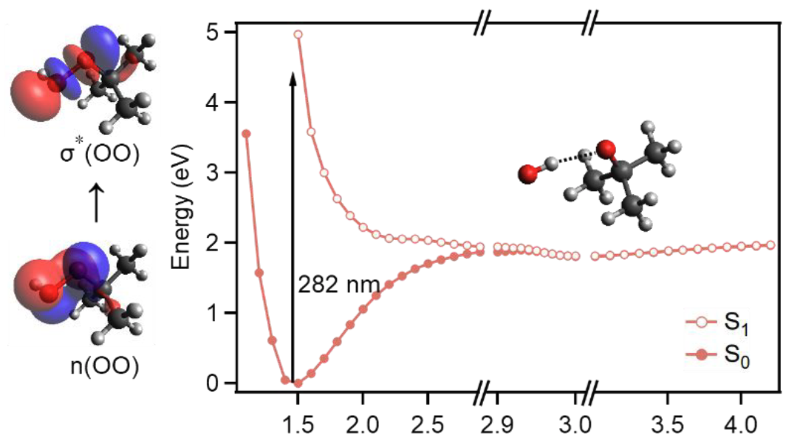
Literature Results vs Current Work
SA(4)- CASPT2(6e,4o)/AVTZ level of theory
SA(4)-CASSCF(6e,4o)/cc-pVDZ level of theory
Zou, M. et al., J. Phys. Chem. A 2025, 129 (13), 3052−3062

